Slide 1
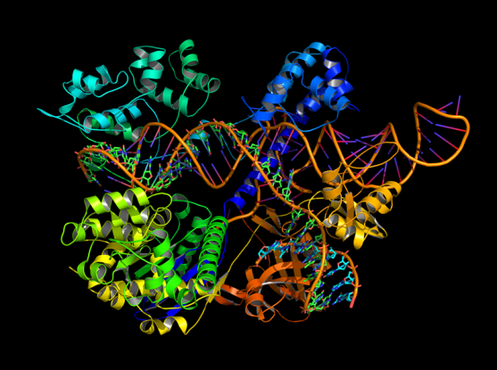
CRISPR-Cas9

Slide 2


Slide 3
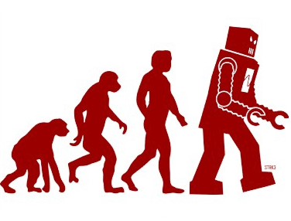

Slide 4


Slide 5
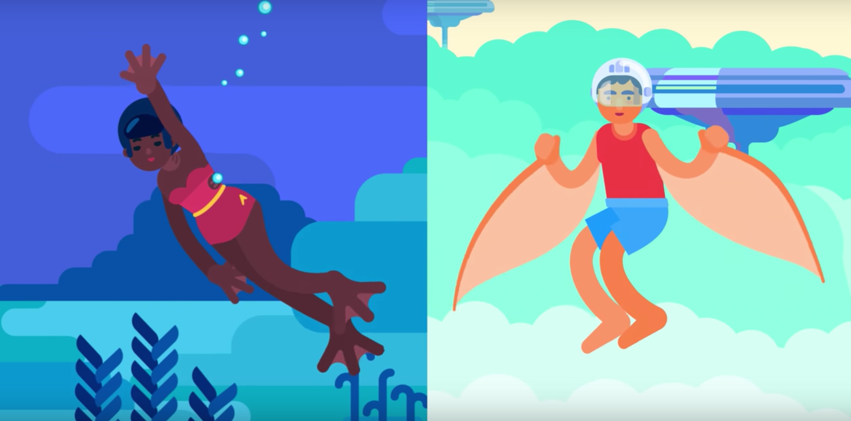

Slide 6
THIS ONE

Slide 7
CRISPR-Cas9

Slide 8
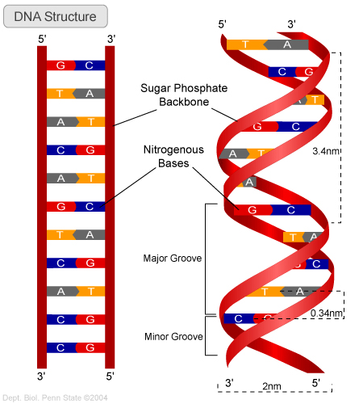
DNA Base Pairing

Slide 9
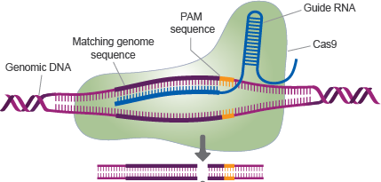
CRISPR-Cas9 Mechanism

Slide 10
Why is this Super Awesome????
Targeted and 99.99999% Specific
Cheap
Takes a really short time to do

Slide 11
HIV, Herpes, most viral diseases

Slide 12
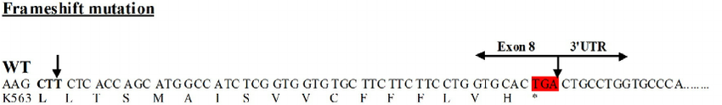
Cystic Fibrosis, Muscular Dystrophy, Any Genetic Disease

Slide 13

Designer Babies

Slide 14
The Future

Slide 15
Questions?

